Slide 1
ICSE 6222: Mobile Tel. Tech

Slide 2
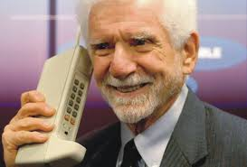

History of Mobile Data Networks
Remember that phones were originally designed for calls

Slide 3
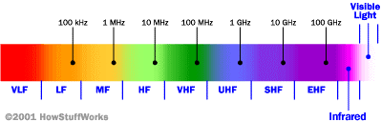
Cellular Network Basics
There are many types of cellular services; before delving into details, focus on basics (helps navigate the “acronym soup”)
Cellular network/telephony is a radio-based technology; radio waves are electromagnetic waves that antennas propagate
Most signals are in the 850 MHz, 900 MHz, 1800 MHz, and 1900 MHz frequency bands
Cell phones operate in this frequency range (note the logarithmic scale)

Slide 4
Cellular Network Generations
It is useful to think of cellular Network/telephony in terms of generations:
0G: Briefcase-size mobile radio telephones
1G: Analog cellular telephony
2G: Digital cellular telephony
3G: High-speed digital cellular telephony (including video telephony)
LTE (4G): IP-based “anytime, anywhere” voice, data, and multimedia telephony at faster data rates than 3G

Slide 5
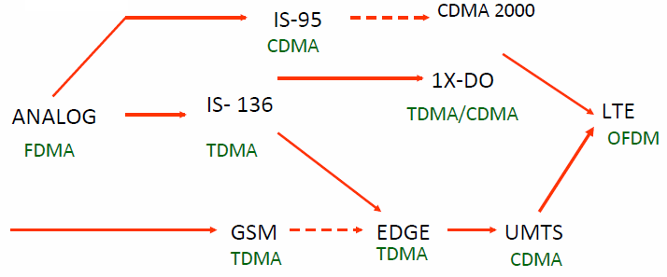
Evolution of Cellular Networks
1G
2G
2.5G
3G
4G

Slide 6
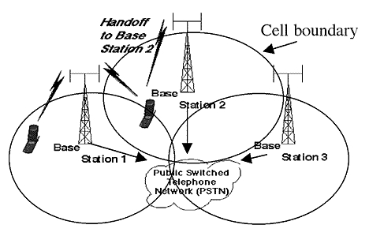
Cellular Network
Base stations transmit to and receive from mobiles at the assigned spectrum
Multiple base stations use the same spectrum (spectral reuse)
The service area of each base station is called a cell
Each mobile terminal is typically served by the ‘closest’ base stations
Handoff when terminals move

Slide 7
The Multiple Access Problem
The base stations need to serve many mobile terminals at the same time (both downlink and uplink)
All mobiles in the cell need to transmit to the base station
Interference among different senders and receivers
So we need multiple access scheme

Slide 8
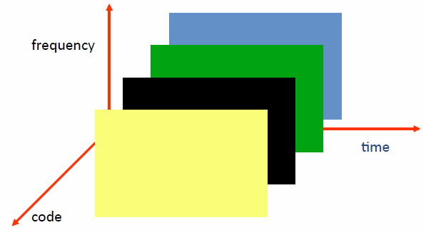
Multiple Access Schemes
3 orthogonal Schemes:
Frequency Division Multiple Access (FDMA)
Time Division Multiple Access (TDMA)
Code Division Multiple Access (CDMA)

Slide 9
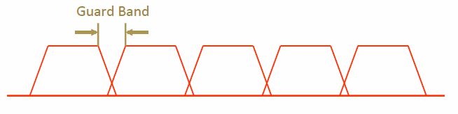
Frequency Division Multiple Access
frequency
Each mobile is assigned a separate frequency channel for a call
Guard band is required to prevent adjacent channel interference
Usually, one downlink band and one uplink band
Different cellular network protocols use different frequencies
Frequency is precious and scare – we are running out of it
Cognitive radio

Slide 10
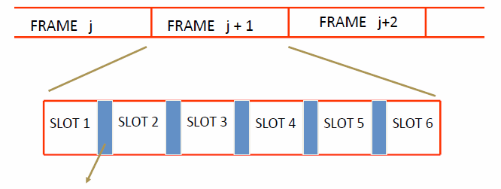
Time Division Multiple Access
Guard time – signal transmitted by mobile terminals at different locations do no arrive at the base station at the same time
Time is divided into slots and only one mobile terminal transmits during each slot
Like during the lecture, only one can talk, but others may take the floor in turn
Each user is given a specific slot. No competition in cellular network
Unlike Carrier Sensing Multiple Access (CSMA) in WiFi

Slide 11
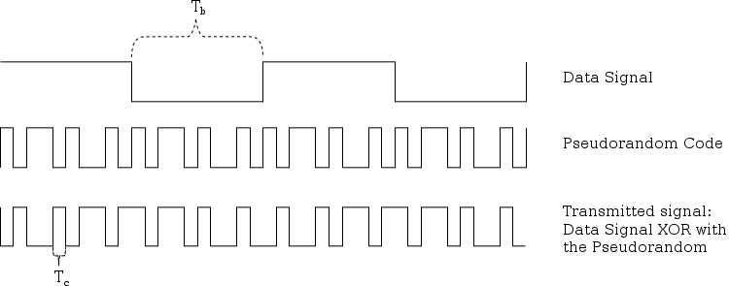
Code Division Multiple Access
Use of orthogonal codes to separate different transmissions
Each symbol of bit is transmitted as a larger number of bits using the user specific code – Spreading
Bandwidth occupied by the signal is much larger than the information transmission rate
But all users use the same frequency band together
Orthogonal among users

Slide 12
Why am I telling you this?
…and cell networks (pre-LTE) were not designed for IP
Instead, optimized for
Circuit-switched
Low bitrate (calls/text)
Charging customers, allowing connections from any cell provider
The performance we get out of cell networks is intimately tied to network design

Slide 13
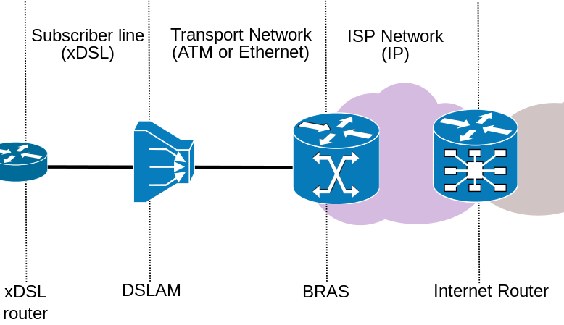
Wired networks are relatively simple
DSL Access Multiplexer:
Separates voice and data
Broadband Remote Access Server:
Bridge between layer 2 and 3, sits in core

Slide 14
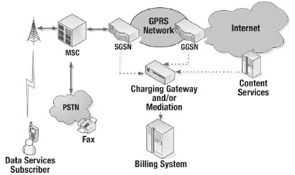
“Simplified” view of 3G
Mobile switching center:
Analog to digital
NodeB & Base Station Controller:
Converts RF to wired
Serving GPRS Support Node:
Move IP packets to/from radio network
Gateway GPRS Support Node:
Route to/from the Interet
$

Slide 15
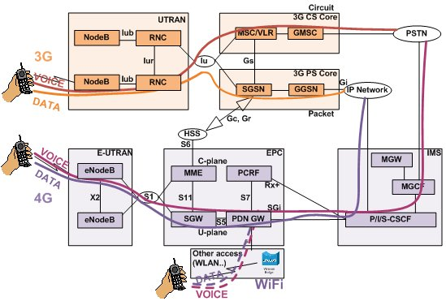
Packet switched vs circuit switched
3G and earlier maintains two data paths
Circuit switched: Phone calls (8kbps) and SMS/MMS
Packet switched: All IP data

Slide 16
Packet switched vs circuit switched
LTE uses “all in one” approach
Everything over IP, including voice
S-GW (Serving Gateway) replaced SGSN, P-GW replaces GGSN

Slide 17
Backward compatibility

Slide 18
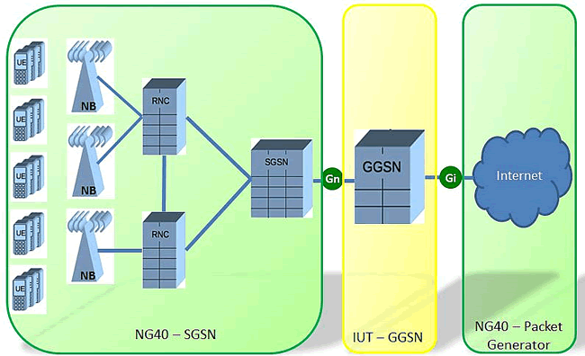
Mobile Architecture in practice
RNC/NodeB: 1000s
SGSNs/S-GWs: 10s or 100s
GGSN/P-GWs: < 10
Why is this a problem?

Slide 19
Very few GGSNs for a large region

Slide 20
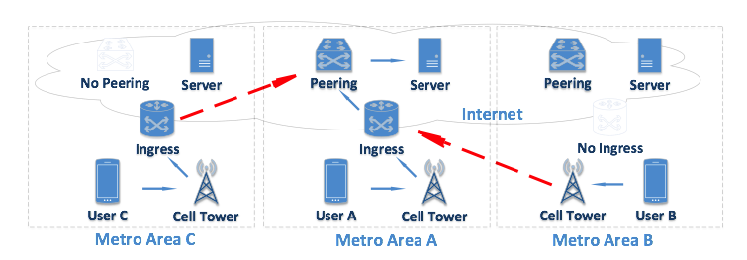
Implication: Path Inflation
Path inflation: Two nearby hosts are connected by a geographically circuitous IP path
Can be caused by
Carrier path
Interdomain policy
Lack of nearby peering points

Slide 21
Path Inflation Example: Ingress

Slide 22
Path Inflation Example: Peering

Slide 23
Inflation breakdown for AT&T

Slide 24
Wireless/Radio Issues
Conflicting goals
IP application assume “always on” connectivity
Radio consumes large amounts of power
How to balance the two?
Compromise in UMTS networks: 3 power states
Idle: No data channel, only paging, almost no power
FACH: Shared, low-speed channel, low power
DCH: Dedicated channel, high speed, high power

Slide 25
Issues with this approach
State promotions have promotion delay
State demotions incur tail times
800 mW
High Bandwidth
DCH
Send/Recv any data
Idle for 5 s
Queue > threshold
IDLE
FACH
Idle for 12 s
460 mW
Low Bandwidth
No Power
No BW

Slide 26
Delays add up…
Delay to send a packet
Delay to save power

Slide 27
… to inefficiency
Inefficient radio utilization (34% power/channel)

Slide 28
LTE Key Features
Uses Multi-input Multi-output (MIMO) for enhanced throughput
Reduced power consumption
Higher RF power amplifier efficiency (less battery power used by handsets)
Lower latency to get access to the medium
Performance sometimes better than WiFi!

Slide 29
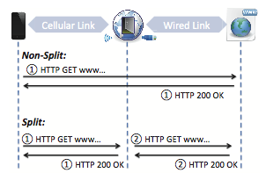
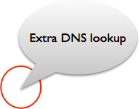
Middleboxes in Mobile Networks
Carrier-grade NAT
Devices often assigned private IPs
Firewalled connections
Content optimizers
Split TCP connections
Why?
Compression and caching
Other strange behavior
How might we measure
these?
Mobile networks
Mobile networks

